Slide 1
Salk Neighborhood Park & Joint Use Development
Draft
Workshop 1
August 9, 2016

Slide 2
Agenda
Introduction
Project Overview and Schedule
Workshop Goals
Site Analysis (Opportunities and Constraints)
Activity 1 – Your Priorities
Activity 2 – Mini Design Charrette
Wrap Up
Next Steps

Slide 3
General Development Plan Process
Introductory Community Workshop
Community Workshop #1
-Opportunities & Constraints Plan
-Community Input
-Design Charrette
Community Workshop #2
-Present Design Alternatives
-Community Input
Develop Design Alternatives
August 2016
November/ December 2016
March 2016
Develop Preferred Plan
Mira Mesa Recreation Council Committee Presentation and Approval
Parks & Recreation Board Presentation
City Review
Mid 2017

Slide 4
Workshop gOALS
Provide information on the opportunities and constraints of the future park site
Gather input on preferred park elements
Incorporate ideas and input into design concepts

Slide 5
Site Analysis

Slide 6
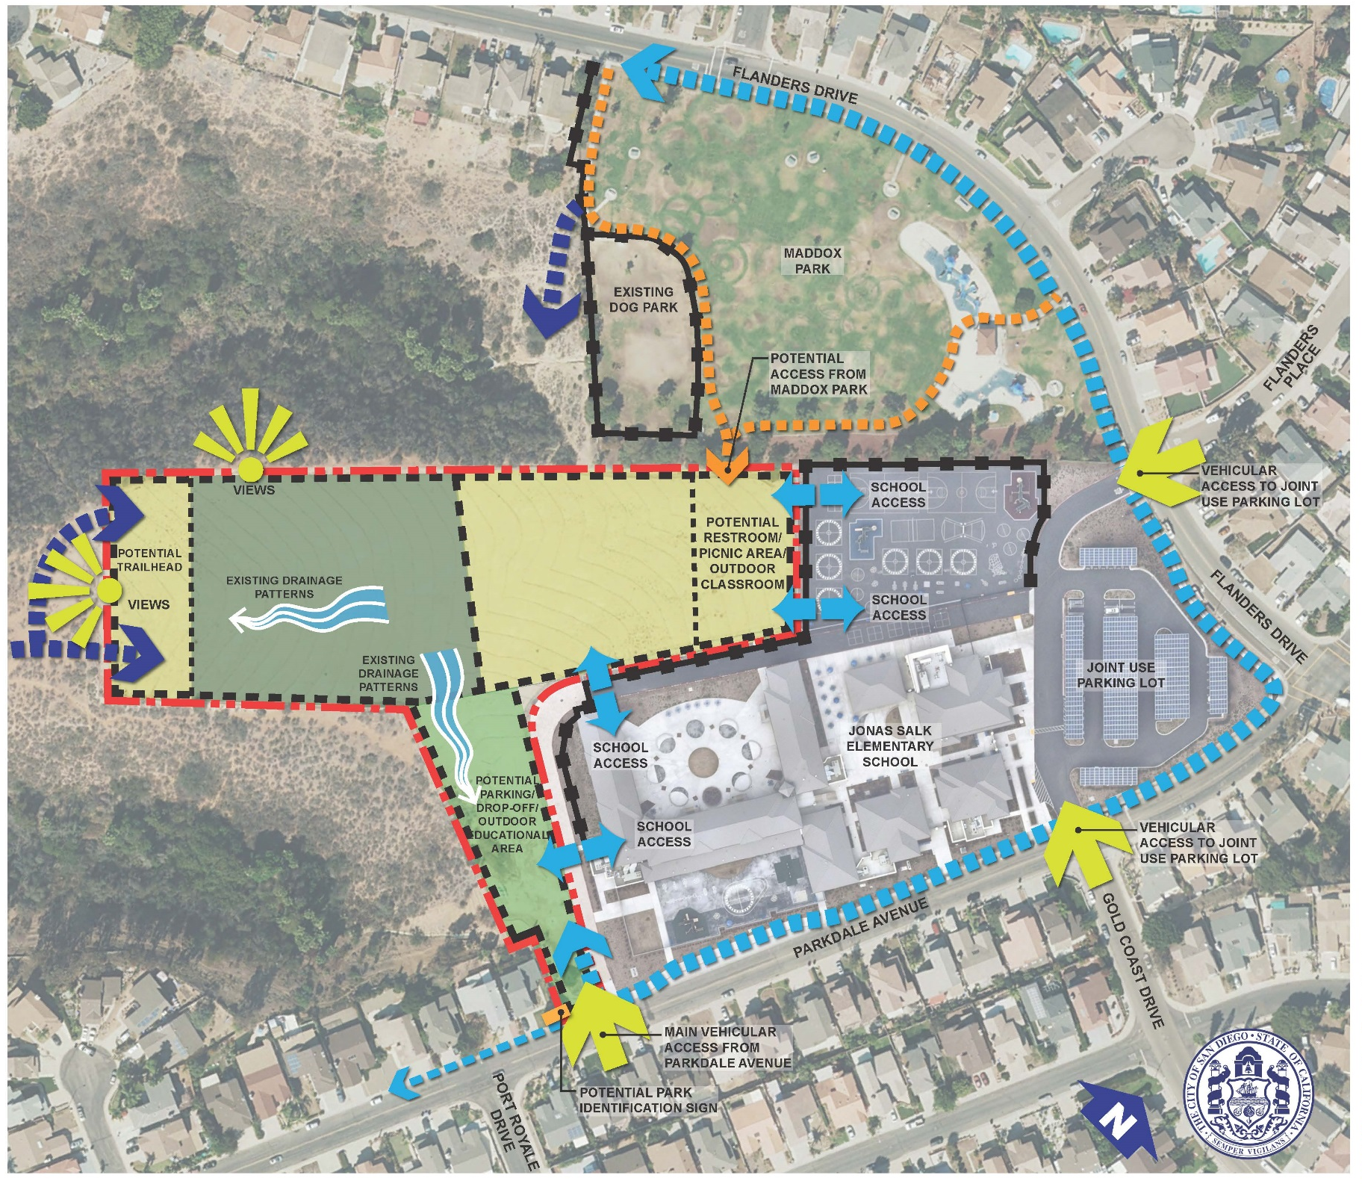
SITE ANALYSIS

Slide 7
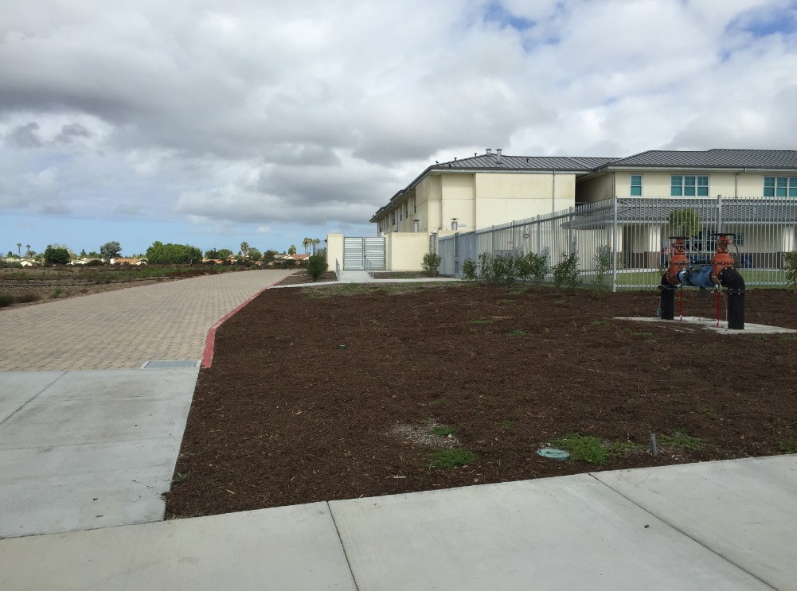
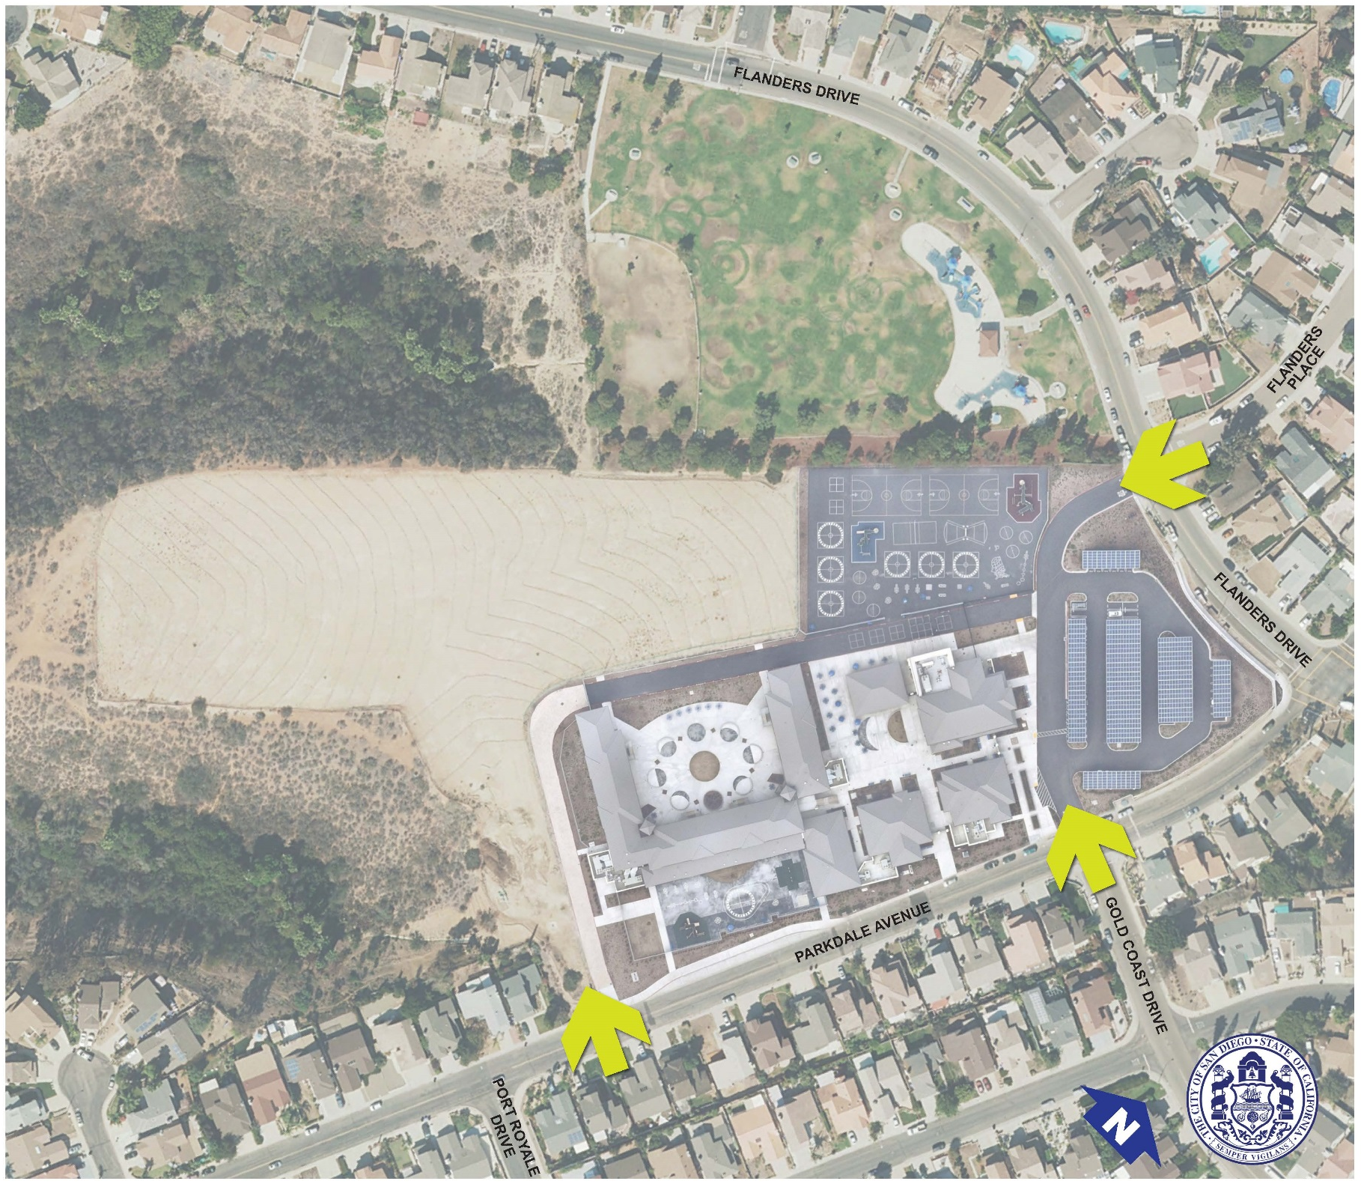
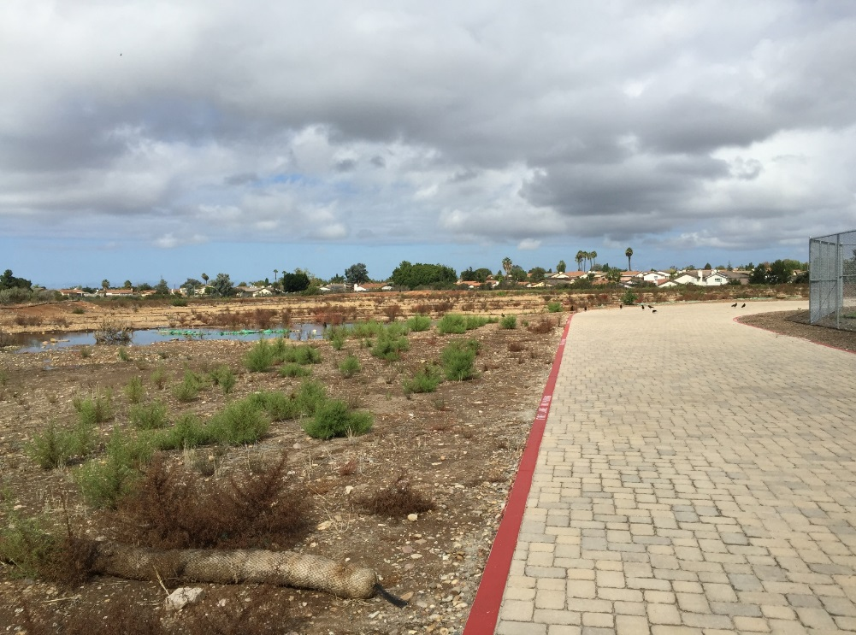
VEHICULAR ACCESS
Salk Elementary School entrances
Main Vehicular Access

Slide 8
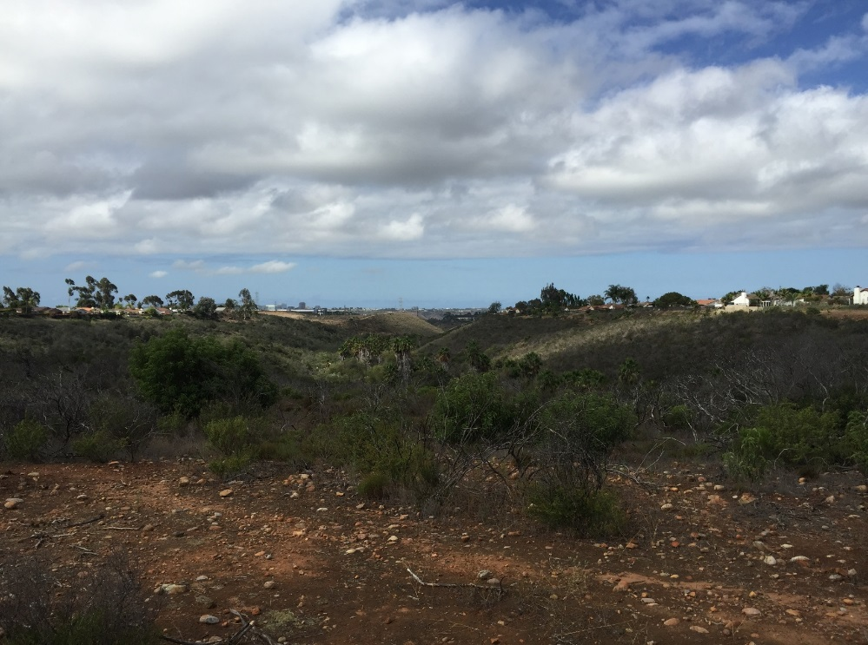
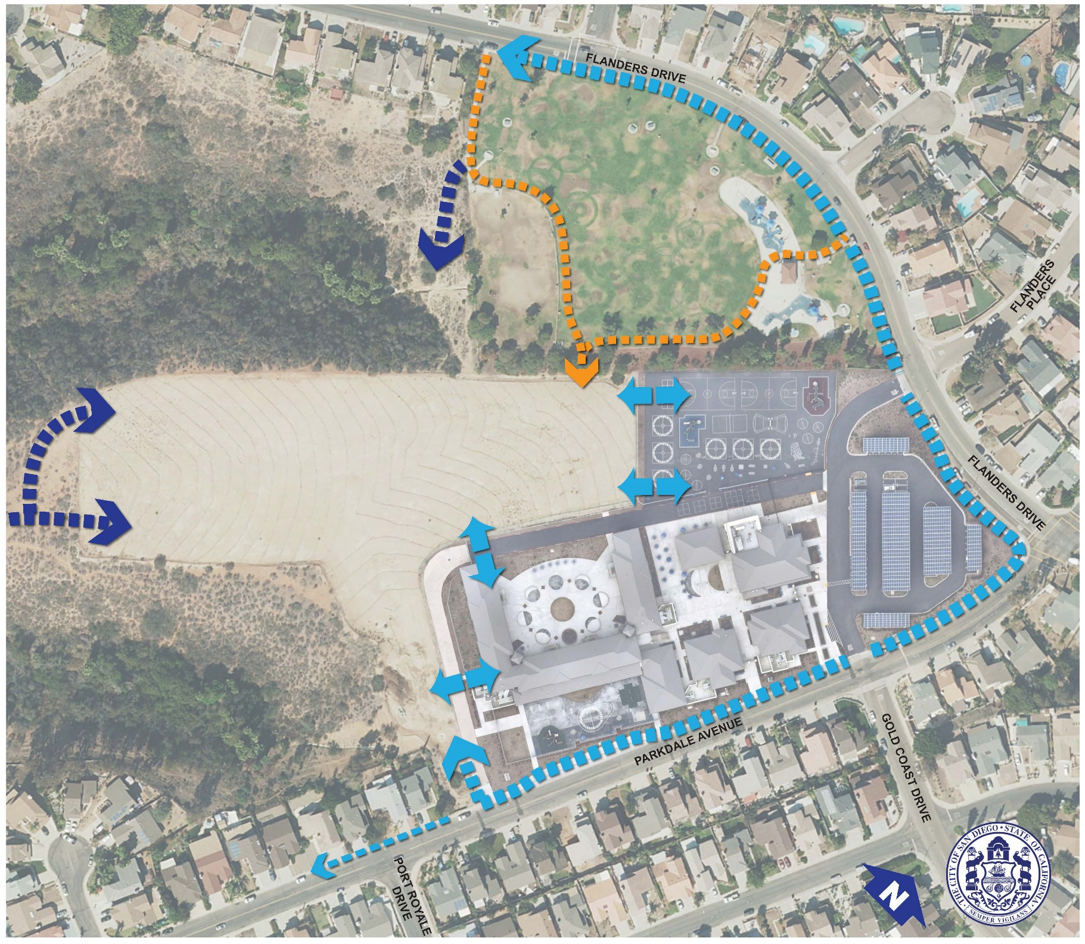
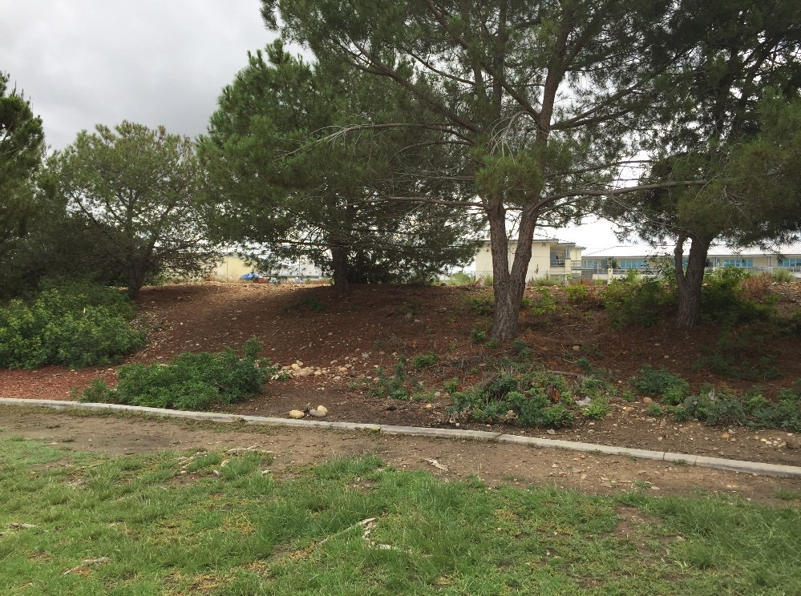
PEDESTRIAN ACCESS

Slide 9
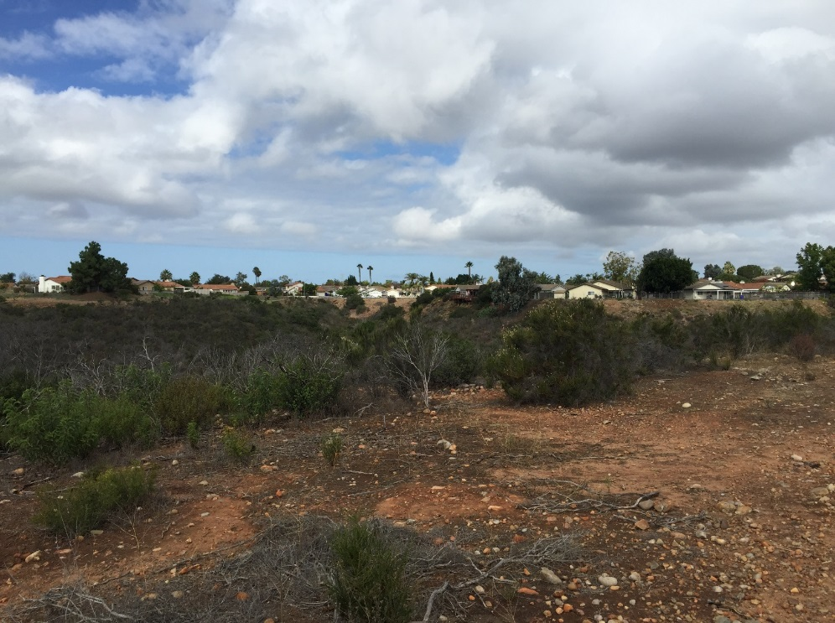
VIEWS
Provide view from school

Slide 10
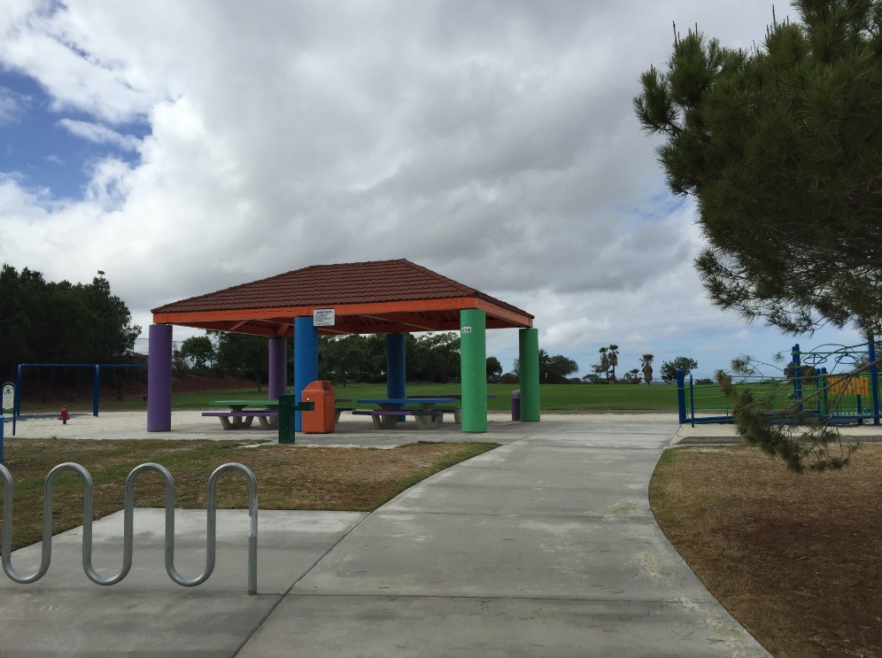
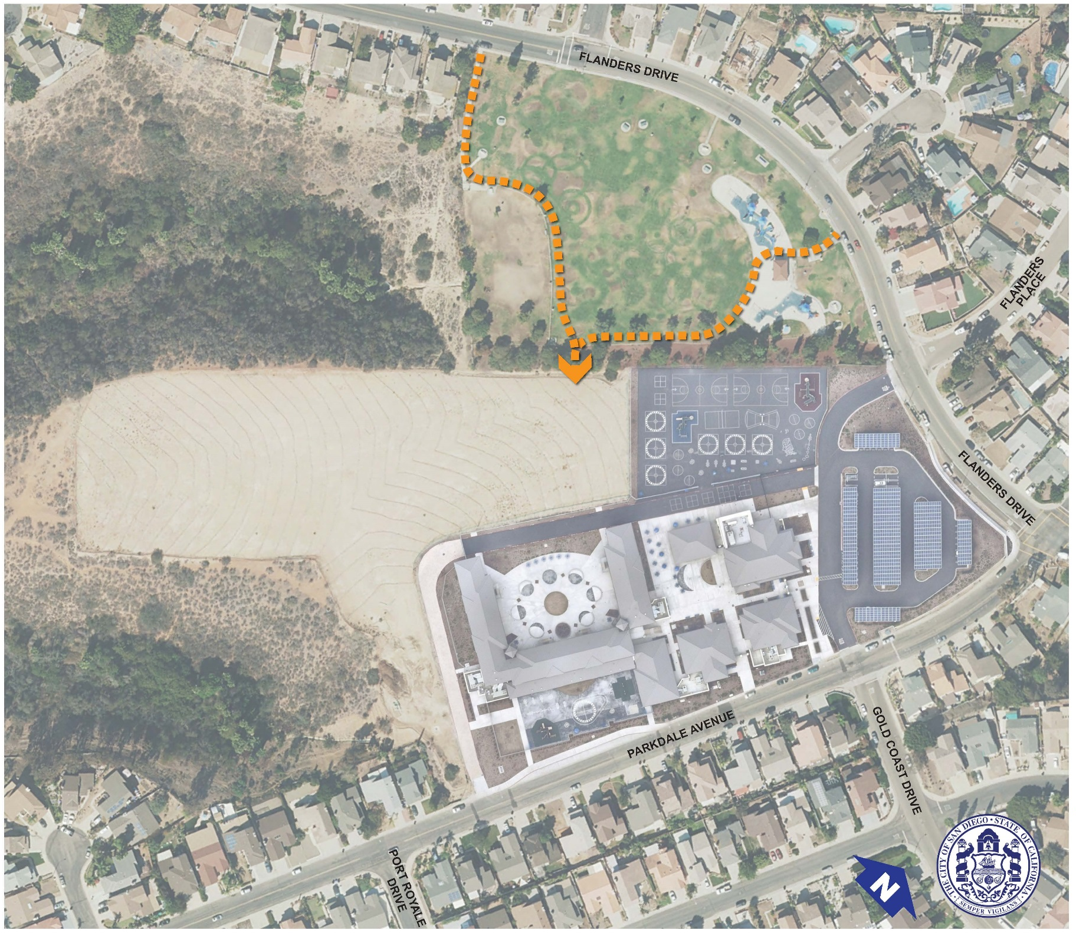
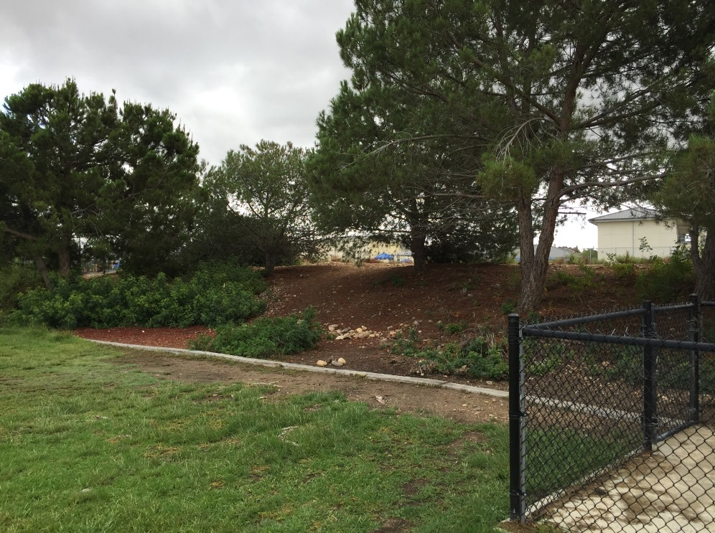
MADDOX PARK ACCESS
Maddox Park
Existing Dog Park

Slide 11
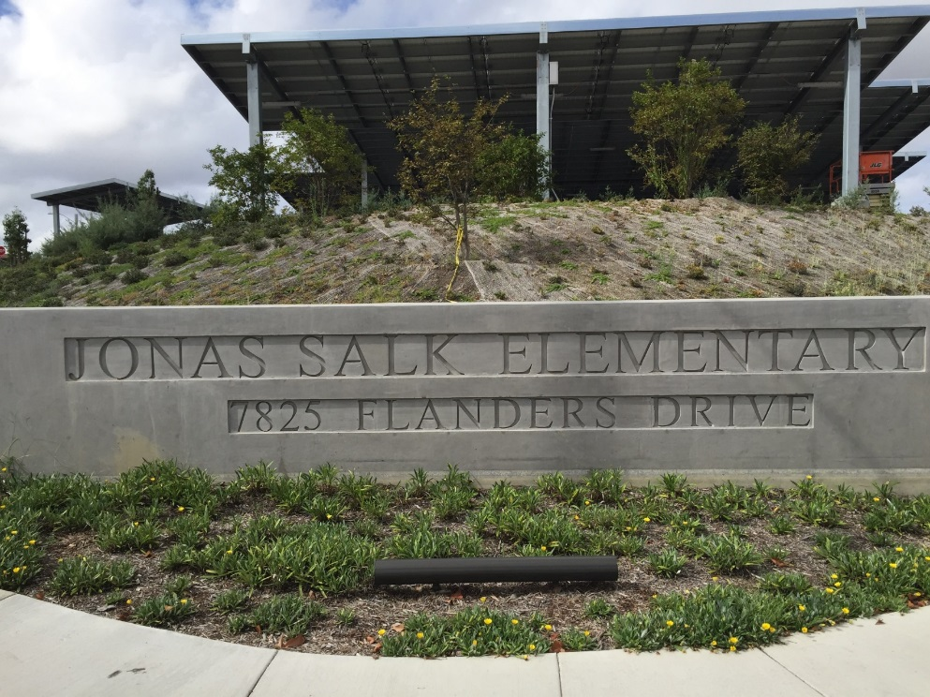
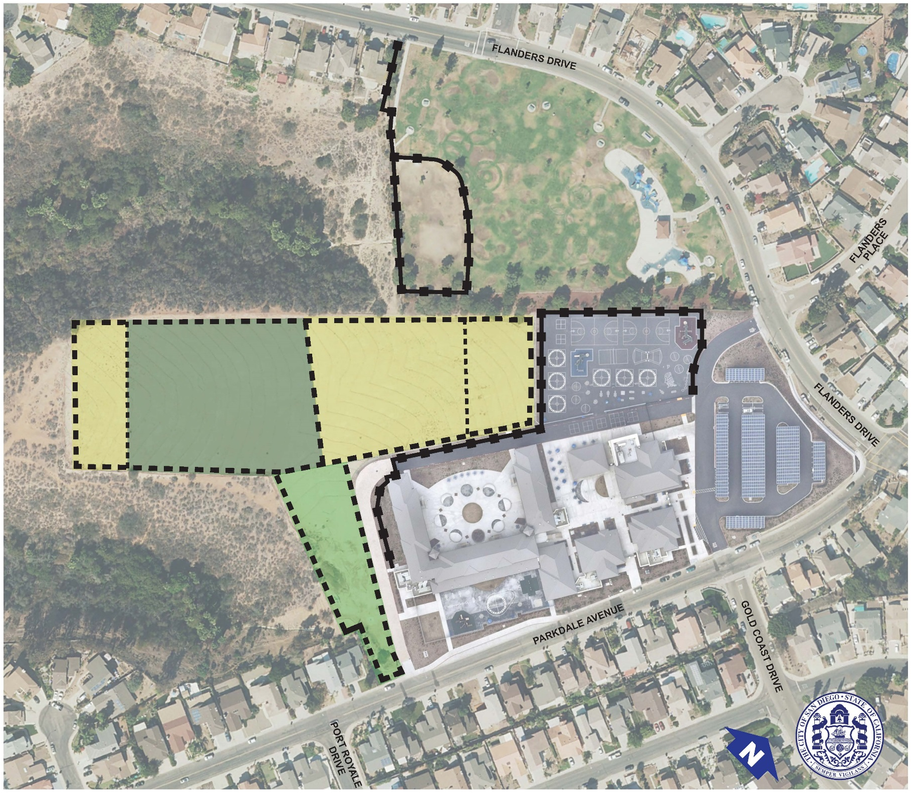
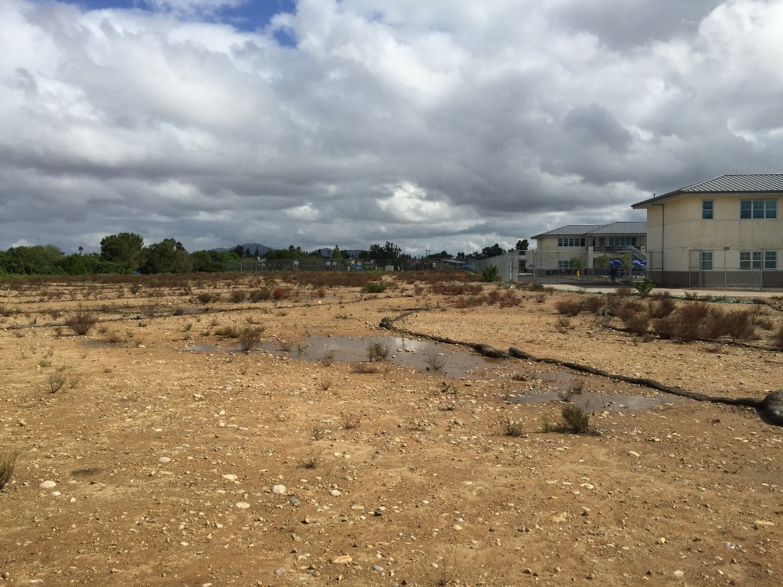
JOINT USE
Joint Use Area

Slide 12
Typical Joint Use Activities
Usually a natural or synthetic turf field with a walking path
Sports fields (soccer, baseball, multi-use)
Other Common Joint Use Activities
Hard Courts (basketball, handball)
Playgrounds
Picnics / Areas
Restrooms
Shade Structure / Educational Gathering Location

Slide 13
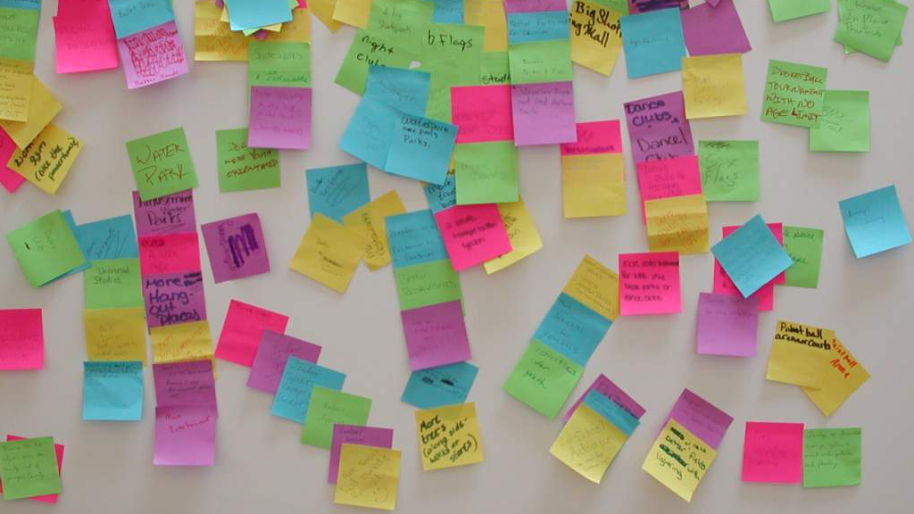
Post-it note activity

Slide 14
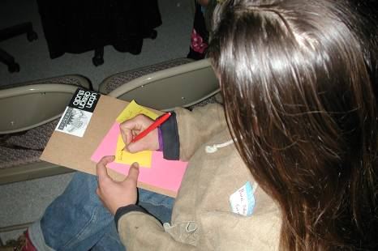
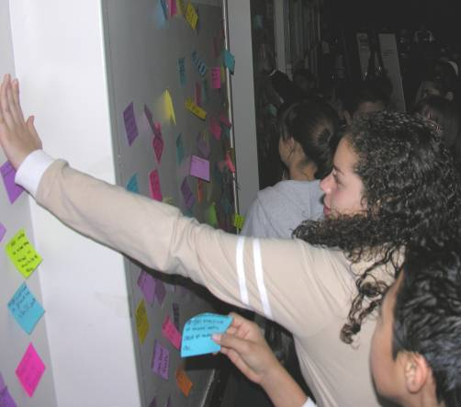
Your Park, Your neighborhood
1
What key issues do you know of at the park site and in the surrounding areas?
Use 2 Post-It Notes
1 thought per note
Place the notes on the wall
One idea on each note!

Slide 15
What Elements Would You Like to See Incorporated into the Park?
2
Use 2 Post-It Notes
1 thought per note
Place the notes on the wall
One idea on each note!

Slide 16
Design Activity

Slide 17
Group Activity Mini-Design Charrette
Building upon the elements generated during Activity 1, each team will use a combination of maps, markers, and other tools to brainstorm a rough design of the park.
Work in teams for approximately 45 minutes. Members of the Project Team will be available as resources.
Present & describe your ideas.
Group member roles:
Discussion leader
Presenter
Recorder

Slide 18
Group Presentations

Slide 19
Project Schedule / next step
*
Introductory Community Workshop
Community Workshop #1
-Opportunities & Constraints Plan
-Community Input
-Design Charrette
Community Workshop #2
-Present Design Alternatives
-Community Input
*
Develop Design Alternatives
November/ December 2016
March 2016
August 2016
Develop Preferred Plan
Mira Mesa Recreation Council Committee Presentation and Approval
Parks & Recreation Board Presentation
City Review
Mid 2017

Slide 20
Thank you!

Slide 21
Salk Neighborhood Park & Joint Use Development
Workshop 1
August 1, 2016

